Slide 1
A PRESENTATION ON
NUCLEAR POWER PLANT
1

Slide 2
CONTENT
2
HISTORY OF NUCLEAR POWER PLANT.
NUCLEAR FUEL.
NUCLEAR FISSION.
NUCLEAR CHAIN REACTION.
NUCLEAR REACTOR.
Components of a nuclear reactor.
Types of Nuclear Reactor.
Working Principle.
NUCLEAR POWER PLANT IN INDIA.
CONCLUSION.

Slide 3
HISTORY OF NUCLEAR POWER-PLANT:-
3
FIRST NUCLEAR POWER-PLANT
◆ Electricity was generated for the first time ever by a nuclear reactor on December 20, 1951 at the EBR-I experimental station near Arco, Idaho in the United States.
◆ On June 27, 1954, the world's first nuclear power plant to generate electricity for a power grid started operations at Obninsk, USSR.
◆ The world's first commercial scale power station, Calder Hall in England opened in October 17, 1956.

Slide 4
NUCLEAR FUEL
4
◆ Nuclear fuel is any material that can be consumed to derive nuclear energy. The most common type of nuclear fuel is fissile elements that can be made to undergo nuclear fission chain reactions in a nuclear reactor.
◆ The most common nuclear fuels are 235U and 239Pu. Not all nuclear fuels are used in fission chain reactions

Slide 5
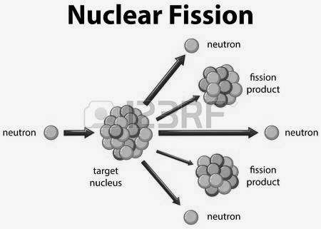

NUCLEAR FISSION
4
◆ When a neutron strikes an atom of uranium, the uranium splits into two lighter atoms and releases heat simultaneously.
◆ Fission of heavy elements is an exothermic reaction which can release large amounts of energy both as electromagnetic radiation and as kinetic energy of the fragments.

Slide 6
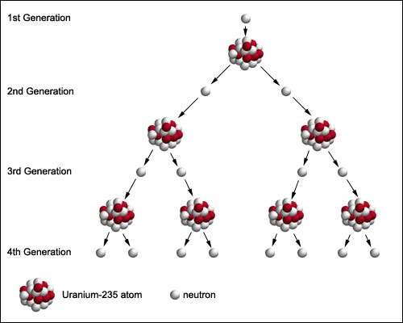
NUCLEAR CHAIN REACTION
5
◆ A chain reaction refers to a process in which neutrons released in fission produce an additional fission in at least one further nucleus. This nucleus in turn produces neutrons, and the process repeats. If the process is controlled it is used for nuclear power or if uncontrolled it is used for nuclear weapons
◆ U235 + n → fission + 2 or 3 n + 200 MeV
◆ If each neutron releases two more neutrons, then the number of fissions doubles each generation.

Slide 7
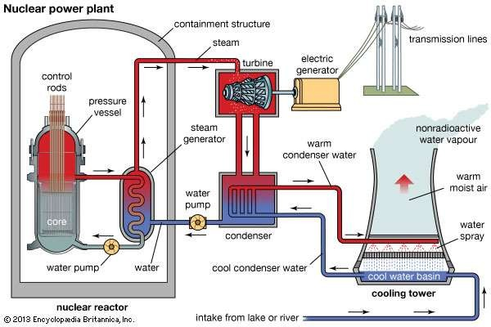
REACTOR
6

Slide 8
COMPONENTS OF A REACTOR
7
Control Rods
Control rods made of a material that absorbs neutrons are inserted
into the bundle using a mechanism that can rise or lower the control rods.
The control rods essentially contain neutron absorbers like, boron, cadmium or indium.
Steam Generators
❖
❖
Steam generators are heat exchangers used to convert water into steam
from heat produced in a nuclear reactor core.
Either ordinary water or heavy water is used as the coolant.

Slide 9
COMPONENTS OF A REACTOR
8
3. Steam Turbine
A steam turbine is a mechanical device that extracts thermal energy from
pressurized steam, and converts it into useful mechanical.
Various high-performance alloys and super alloys have been used for steam generator tubing.
4. Coolant Pump
The coolant pump pressurizes the coolant to pressures of the order of
155bar.
The pressure of the coolant loop is maintained almost constant with the help of the pump and a pressurize unit.

Slide 10
COMPONENTS OF A REACTOR
9
5. Feed Pump
Steam coming out of the turbine, flows through the condenser for condensation and recalculated for the next cycle of operation.
The feed pump circulates the condensed water in the working fluid loop.
6. Condenser
Condenser is a device or unit which is used to condense vapor into liquid.
The objective of the condenser are to reduce the turbine exhaust pressure to increase the efficiency and to recover high quality feed water in the form of condensate & feed back it to the steam generator without any further treatment

Slide 11
COMPONENTS OF A REACTOR
10
7. Cooling Tower
Cooling towers are heat removal devices used to transfer process waste heat to the atmosphere.
Water circulating through the condenser is taken to the cooling tower for cooling and reuse

Slide 12
TYPES OF NUCLEAR REACTOR
11
◆ Reactors can be heterogeneous or homogeneous. A heterogeneous reactor has a large number of fuel rods with the coolant circulating around them and carrying away the heat released by nuclear fission. In a homogeneous reactor, the fuel and moderator are mixed, e.g. A fissionable salt of uranium like uranium sulphate or nitrate dissolved in the moderator like H2O Or D2O.
------TYPES:------
Boiling water reactor (BWR)
Pressurized water reactor (PWR)
Pressurized heavy water reactor (PHWR)
High-temperature gas-cooled reactor reactor (HTGR)
Liquid-metal fast breeder reactor (LMFBR)
Show turbine/generator plant common to all types

Slide 13
HOW A NUCLEAR REACTOR WORKS
12
235U fissions by absorbing a neutron and producing 2 to 3 neutrons, which initiate on average one more fission to make a controlled chain reaction
Normal water is used as a moderator to slow the neutrons since slow neutrons
take longer to pass by a U nucleus and have more time to be absorbed
The protons in the hydrogen in the water have the same mass as the neutron and stop them by a billiard ball effect
The extra neutrons are taken up by protons to form deuterons
235U is enriched from its 0.7% in nature to about 3% to produce the reaction,
and is contained in rods in the water
Boron control rods are inserted to absorb neutrons when it is time to shut down the reactor
The hot water is boiled or sent through a heat exchanger to produce steam.
The steam then powers turbines

Slide 14
NUCLEAR POWER IN INDIA
13
Nuclear power is the fourth-largest source of electricity in India after thermal, hydroelectric and renewable sources of electricity.
As of 2017, India has 25 nuclear reactors in operation in six nuclear power plants, generating 4,780 MW while five other plants are under construction and are expected to generate an additional 3,153 MW.
India's nuclear power industry is undergoing rapid expansion with plans to increase nuclear power output to 64,000 MW by 2032. The country is involved in the development of nuclear fusion reactors through its participation in the ITER project and is a global leader in the development of thorium-based fast breeder reactors.

Slide 15

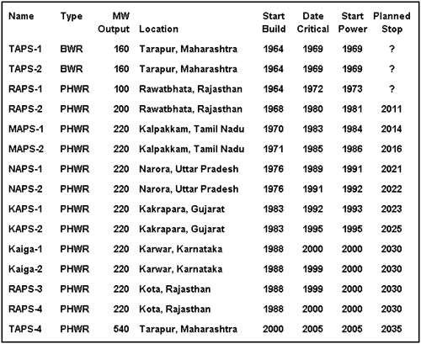
Nuclear Power Plants in India
14

